Slide 1
Legacy of Dragon Holt Adaptation
Galen, Jason, Travis, Michael

Slide 2
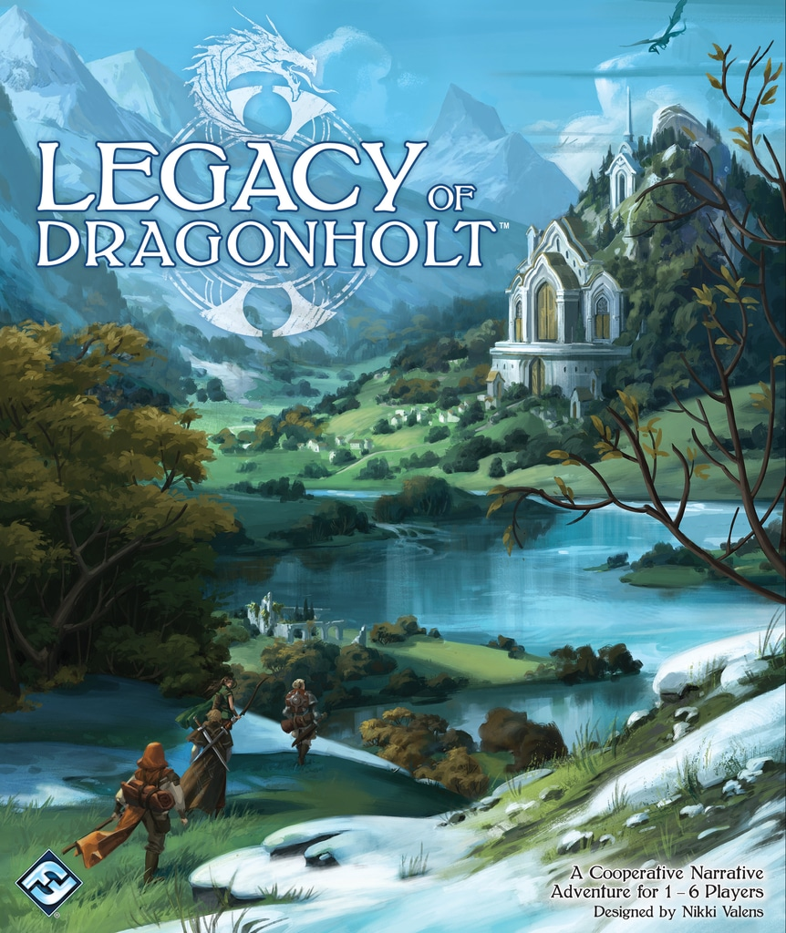
Goals and Ambitions
Take the Rules set of Legacy of Dragons Holt and adapt it 1:1
Have both Character Creation and The first Intro Sequence of the game be fully playable
SFML Implementation

Slide 3
Design
Main.cpp
Main code that contains the game itself
PC.H/PC.CPP
Code that Contains the Base Class Player Character(PC) which contains the players gold, stamina, and experience. As well as the list of skills from the game the character get learn
Race.H/Race.cpp
Contains the code for the derived class for all the Races in the game, which contains their descriptions and code to check if PC has required skills related to the class
Character_Class.H/.Cpp
Contains code for the derived class for all Classes the character can choose during character creation. Similar to Race.H/.Cpp
Character_Creation.cpp
Contains the code for the character creation function

Slide 4
Demo

